Slide 1
Better Tools via Drawings
Michael McLennan
HUBzero® Platform for Scientific Collaboration
Purdue University
This work licensed under
Creative Commons
See license online:
by-nc-sa/3.0

Slide 2
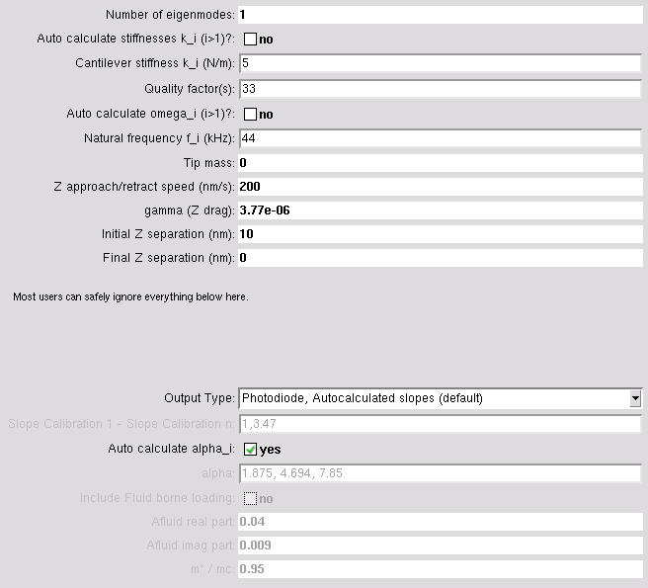
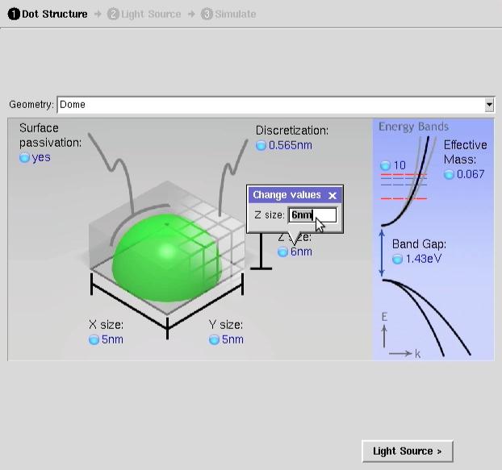
Transform Your Tools
From this…
…To this

Slide 3
Drawing Input
<input>
<drawing>
<about>
<label>Schematic System</label>
<description>Picture of the system.</description>
</about>
<background>…</background>
<components>
<hotspot>…</hotspot>
<line>…</line>
<oval>…</oval>
<picture>…</picture>
<polygon>…</polygon>
<rectangle>…</rectangle>
<text>…</text>
</components>
<substitutions>…</substitutions>
</drawing>
…
Background color
and coordinates
Drawing
elements
Current values
for text items

Slide 4


Background
(0,0)
<input>
<drawing>
<background>
<width>150</width>
<height>300</height>
</background>
…
Or
<input>
<drawing>
<background>
<width>300</width>
<height>200</height>
<color>yellow</color>
<coords>-1 3 2 5</coords>
</background>
…
150
300
(1,1)
(-1,3)
300
200
(2,5)

Slide 5
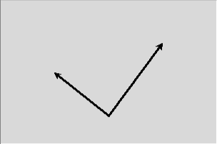
Drawing Component: Line
(0,0)
<input>
<drawing>
<components>
<line>
<coords>.25 .5 .5 .8 .75 .3</coords>
<color>black</color>
<linewidth>3</linewidth>
<arrow>both</arrow>
</line>
…
</components>
</drawing>
…
(1,1)

Slide 6
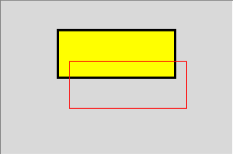
Drawing Component: Line
<input>
<drawing>
<components>
<rectangle>
<coords>.25 .2 .75 .5</coords>
<outline>black</outline>
<fill>yellow</fill>
<linewidth>3</linewidth>
</rectangle>
<rectangle>
<coords>.3 .4 .8 .7</coords>
<outline>red</outline>
<fill></fill>
</rectangle>
</components>
</drawing>
…
(0,0)
(1,1)

Slide 7
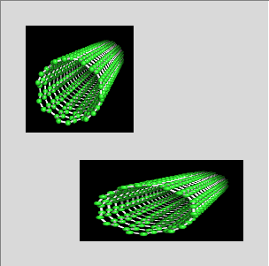
Picture
(0,0)
(0.1,0.1)
<input>
<drawing>
<components>
<picture>
<coords>0.1 0.1</coords>
<width>0.4</width>
<height>0.4</height>
<anchor>nw</anchor>
<contents>file://cnt.png</contents>
</picture>
<picture>
<coords>0.3 0.6 0.9 0.9</coords>
<contents>file://cnt.png</contents>
</picture>
</components>
</drawing>
…
(0.3,0.6)
(0.9,0.9)
(1,1)

Slide 8
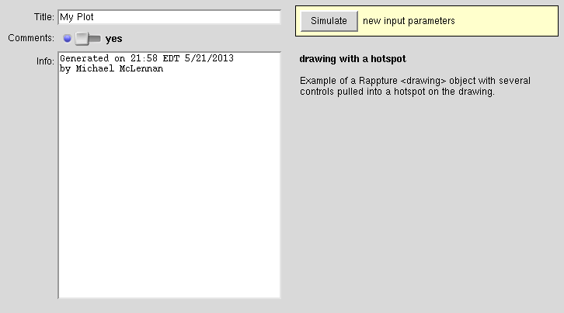
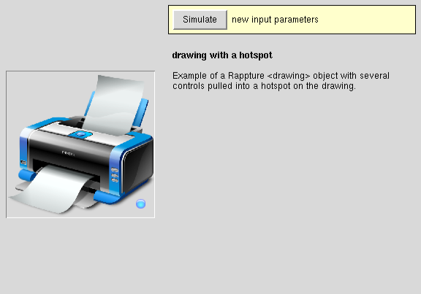
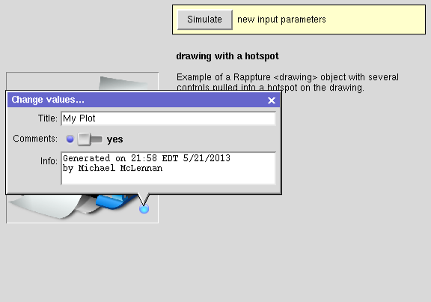
Hotspot
Suppose you have a tool like this…
Pull the controls
into a drawing at a
hotspot

Slide 9
Hotspot
(0,0)
<input>
<drawing>
<components>
<picture>
<coords>0 0 1.0 1.0</coords>
<contents>file://printer.png</contents>
</picture>
<hotspot>
<coords>.9 .9</coords>
<controls>input.string(title)</controls>
<controls>input.boolean(cntl)</controls>
<controls>input.string(comments)</controls>
</hotspot> …
</components>
</drawing>
<string id=“title”>…</string>
<boolean id=“cntl”>…</boolean>
<string id=“comments”>…</string>
(1,1)
Controls get
pulled into
hotspot

Slide 10

Text
<input>
<drawing>
<components>
<text>
<coords>.25 .25</coords>
<anchor>nw</anchor>
<text>Hello</text>
<color>red</color>
<font>Helvetica 36 bold</font>
</text>
<text>
<coords>0.75 0.75</coords>
<anchor>se</anchor>
<text>World!</text>
<color>black</color>
<font>Helvetica 28 italic</font>
</text>
</components>
</drawing>
…
(0,0)
(1,1)

Slide 11
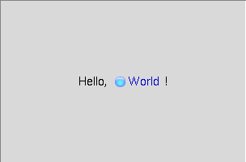
Substitutions
<input>
<string id="info">
<default>World</default>
</string>
<drawing>
<substitutions>
<variable>
<name>person</name>
<path>input.string(info)</path>
</variable>
</substitutions>
<components>
<text>
<coords>.5 .5</coords>
<text>Hello, ${person}!</text>
</text>
</components>
</drawing>
…
Like a hotspot
Controls get
pulled into
hotspot

Slide 12
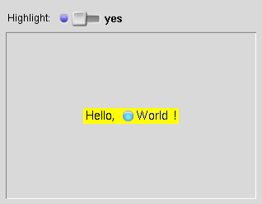
More advanced substitutions
<input>
<boolean id="switch">
<about><label>Highlight</label></about>
<default>off</default>
</boolean>
<drawing>
<substitutions>
<variable>
<name>color</name>
<path>input.boolean(switch)</path>
<map><from>yes</from><to>yellow</to></map>
<map><from>no</from><to>gray</to></map>
</variable>
</substitutions>
<components>
<text>
<coords>.5 .5</coords>
<text>Hello, ${person}!</text>
<fill>${color}</fill>
</text>
Boolean controls
background color

